Slide 1


Java ee
(ADVANCE JAVA)
Lecture-46

Slide 2
Today’s Agenda
Introduction To Custom Tags
Advantages Of Custom Tags
Classes And Interfaces Used For Custom Tags
Examples

Slide 3
INTRODUCTION TO CUSTOM TAGS
In today’s development , the main focus is to use as less java code as possible in the jsp page .
Till now we have achieved this through Java Beans and EL but they both have a drawback which is that they may just create , initialize and access objects but cannot perform any kind of processing

Slide 4
INTRODUCTION TO CUSTOM TAGS
For example there is no Bean or EL approach to fetch the data from database and display it or to run a loop or to apply a particular condition before generating the output
To remove all the above drawbacks , the jsp technology has given the facility to create our own tags and this in jsp is called programmer defined or custom tags.

Slide 5
STEPS FOR CREATING CUSTOM TAGS
To create our own tags and used it in the jsp page we have to follow these steps :
Create a class which is called Tag handler class
Create a file called TLD(tag library descriptor).
Write the JSP page and use the tag there

Slide 6
CREATING TAG HANDLER CLASS
A Tag Handler class in JSP is a special class which has some predefined methods called callbacks which the container calls the moment it encounters a tag in JSP page .
To create Tag Handler class JSP specification provide us some special set of methods which are available in some interfaces and classes which he have to inherit and override
All these interfaces/classes are available in the package
javax.servlet.jsp.tagext.*;

Slide 7
INTERFACES AND CLASSES
Following are it’s important interfaces and classes:
Tag (interface):This is the base interface provides us two methods called doStartTag() and doEndTag() called by container when ever it finds opening or closing of our tag.
IterationTag (interface): This interface extends the Tag interface and provides method called doAfterBody() which allows us to apply looping over our tag.

Slide 8
INTERFACES AND CLASSES
BodyTag(interface) : This extends the IterationTag interface and has a method called doInitBody() which provides access to tag body.
TagSupport(Class): It implements the IterationTag interface and works as a helper class while developing out tag handler classes

Slide 9
INTERFACES AND CLASSES
5. BodyTagSupport(Class): It implements the BodyTag interface as well as extends TagSupport class and can be used by tag handlers which have to interact with the body of the tag.

Slide 10
DEFINING BODY-LESS TAGS
A bodyless action is an element that is not having an end tag, cannot enclose a body between start and end tags.
As an example, let’s say we want to develop a custom tag that prints current date on the browser window.

Slide 11
DEFINING BODY-LESS TAGS
Our tag in jsp would be:
<mytag:showdate/>
To achieve this we will first have to define our Tag Handler class

Slide 12
DEFINING TAG HANDLER CLASS
package classicTag;
import javax.servlet.jsp.tagext.*;
import javax.servlet.jsp.*;
import java.io.*;
import java.util.*;
public class MyDateTag extends TagSupport
{
public int doStartTag() throws JspTagException
{
try
{
JspWriter out=pageContext.getOut();
Date today=new Date();
out.println("<H1 align='center'>"+today+"</h1>");
}
catch(IOException e)
{
throw new JspTagException("Error:"+e.getMessage());
}
return SKIP_BODY;
}

Slide 13
DEFINING TAG HANDLER CLASS
public int doEndTag()
{
return EVAL_PAGE;
}
}

Slide 14
THE doStartTag( ) METHOD
As soon as the container finds a custom tag in the JSP page it will create a new object of our Tag Handler class MyDateTag and will initialize it.
Then it calls the method doStartTag( ).
The doStartTag() method returns a flag that signals the container to process the body or to ignore it.

Slide 15
THE doStartTag( ) METHOD
These return values are either of two: SKIP_BODY or EVAL_BODY_INCLUDE .
Both are static integers defined in the interface Tag
Bodyless tags must return the value to ignore the body which is SKIP_BODY.

Slide 16
THE doEndTag( ) METHOD
After the doStartTag() method, the container calls the doEndTag() method.
The doEndTag() method should return a flag to the container to signal whether everything was okay in processing of that tag and the page evaluation is clear to resume, or whether something went wrong and the page must be abandoned.

Slide 17
THE doEndTag( ) METHOD
These return values are either of two: SKIP_PAGE or EVAL_PAGE .
Both are static integers defined in the interface Tag

Slide 18
THE TLD FILE
After we have written our custom tag the next step is to link it to the JSP page.
This is done by creating an XML file called the TLD ( Tag Library Descriptor) File.
The TLD is an XML file that describes our tags so that Tomcat knows how to deal with them

Slide 19
THE TLD FILE
<?xml version="1.0" encoding="ISO-8859-1"?>
<taglib xmlns="http://java.sun.com/xml/ns/j2ee"
xmlns:xsi="http://www.w3.org/2002/XMLSchema-instance"
xsi:schemaLocation="http://java.sun.com/xml/ns/j2ee/web-jsptaglibrary_2_0.xsd" version="2.0">
<jsp-version>2.1</jsp-version>
<tlib-version>1.0</tlib-version>
<short-name>hello</short-name>
<description>Date Display Example</description>
<tag>
<name>showdate</name>
<tag-class>classicTag.MyDateTag</tag-class>
<body-content>empty</body-content>
</tag>
</taglib>

Slide 20
THE TLD FILE
As we can see, the outermost element is taglib, which contains a tag element for each custom action . Apart from tag, all taglib sub-elements in the example are for information purposes or to be used by tools and can be omitted.
The tag element contains various sub-element . The sub-element name defines the custom tag name; tag-class specifies the fully qualified class name of the tag handler class ; and body-content specifies the action to be bodyless.
We have mentioned the value empty for body-content which means tag is not having any body.
The other value for body-content is JSP is the default and means that the body can contain JSP elements.

Slide 21
SAVING THE TLD FILE
After we have designed the TLD file we have to save it in WEB-INF or any of it’s subdirectories.
We will save it in a sub-directory called tlds

Slide 22
WRITING THE JSP PAGE
To use a custom tag, we need to use the taglib directive in our JSP page. It’s general syntax is:
<%@ taglib uri=“path to TLD” prefix=“some prefix”%>
The uri attribute of the taglib directive refers to the path of TLD file.
The prefix attribute defined in the taglib directive is used to uniquely identify our tag.

Slide 23
WRITING THE JSP PAGE
<%@ taglib uri="/WEB-INF/tlds/DateTag.tld" prefix=“p” %>
<html>
<head>
<title>Welcome To Classic Tags</title>
</head>
<body bgcolor="pink">
<p:showdate/>
</body>
</html>

Slide 24
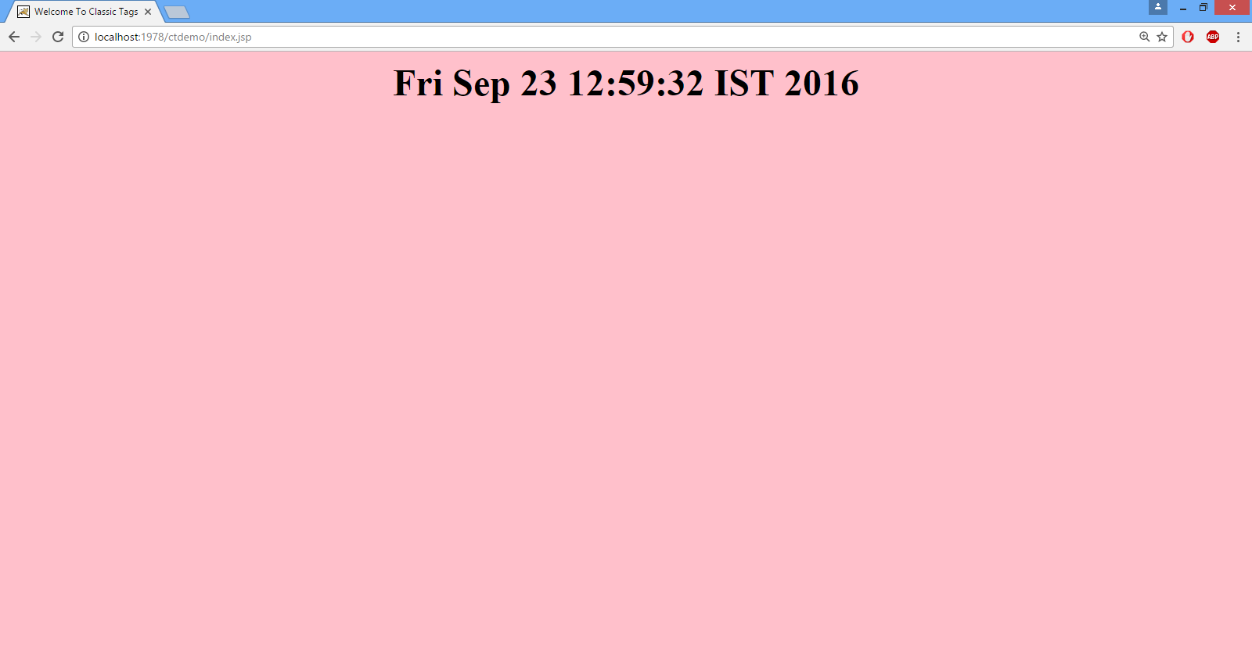
THE OUTPUT

Slide 25

End Of Lecture
For any queries mail us @: scalive4u@gmail.com
Call us @ : 0755-4271659, 7879165533
Agenda for Next Lecture:
Custom Tags With Attributes
Custom Tag With Body
Iterating Over Tag Body
Accessing Tag Body In Tag Handler

